Slide 1
West School Aged
Immunisation Team

Slide 2
Year 9 Injections
DTP and Men ACWY

Slide 3
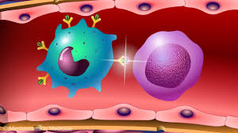
The vaccinations
Getting the vaccine helps protect you against Diphtheria, Tetanus and Polio and the Meningococcal ACWY diseases.
Its stimulates your immune system, so that you have the antibodies needed to fight the infection if you come into contact with disease.

Slide 4
What is Diphtheria, Tetanus and Polio
Diphtheria – a contagious bacterial infection which effects the upper respiratory tract (chest and throat) and occasionally the skin.
Tetanus – a bacterial infection that can attack the muscles and nervous system
Polio (poliomyelitis) - a contagious virus which can attack the nervous system. It can sometimes cause paralysis of the arms or legs
These diseases are now rare in this country due to immunisations

Slide 5
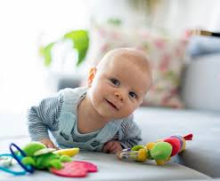
Diphtheria, Tetanus and Polio vaccination
The Diphtheria, Tetanus and Polio vaccination is also given to you as a baby and before starting school. That is why we call this one your booster vaccination as it ‘boosts’ your protection against those diseases before you leave school.

Slide 6
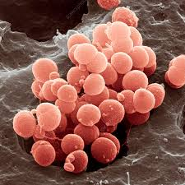
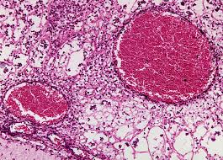
What is Meningococcal ACWY
Meningococcal ACWY is four strains of a bacterial infection which can cause meningitis and blood poisoning (septicemia).

Slide 7
Meningitis and Septicaemia
Meningitis - is a dangerous swelling of the lining around the brain and spinal cord. It can be the result of infection with bacteria or a virus or as a result of injury.
Septicaemia - is when bacteria enter the bloodstream and cause blood poisoning which can trigger sepsis. Sepsis is an overwhelming and life-threatening immune response to any infection and can lead to tissue damage, organ failure and death.

Slide 8
Who can have the vaccination
Children aged 13 to 15 (school Years 9 or 10) are routinely offered the Men ACWY vaccine in school alongside the Diphtheria Tetanus and Polio vaccine (the 3 – 1 booster).

Slide 9
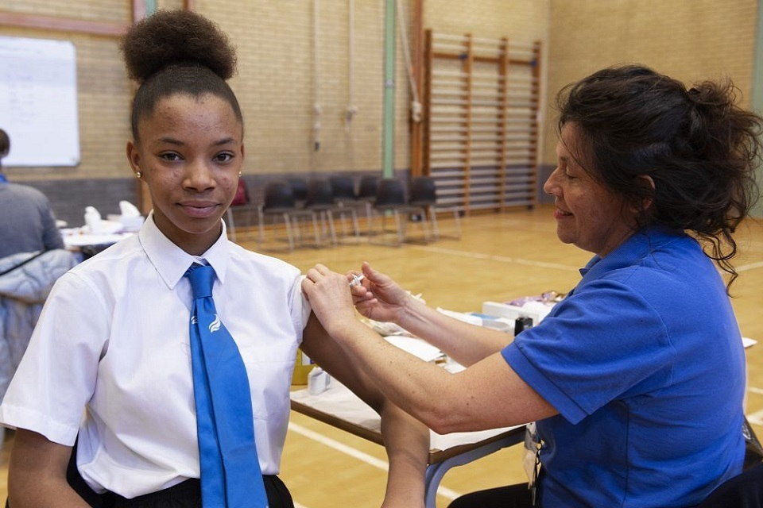
How will you have the vaccinations
You will have two injections at the same time – one in each upper arm, or individually, 2.5cm apart in the same arm.
Nobody likes injections, but it is very quick.

Slide 10
Vaccinations are important to prevent you from getting these serious diseases or viruses.
Vaccinations keep you healthy !

Slide 11
Consent forms
We can’t give you your injection without receiving your consent form.
Make sure you ask your parents to fill in the form and together look at the information you receive in your information pack.
Return it signed, in pre-paid envelope by post. Before the deadline date!

Slide 12
On the day
On the day remember to be considerate to those having their injection.
Have your breakfast in the morning.
1
Wear a short sleeve shirt or vest top under your shirt.
2
The nurse will ask you some simple health questions. You can ask questions too!
3
You will wait a few minutes after the injection before going back to class with your friends or in a small group.
4
If you are very nervous or have any special needs or concerns please let your teacher know or speak to the nurse on the morning of the session
5

Slide 13
What do Others say ?
I just felt a little scratch and it was over very quickly. Nurses were very kind and calming. Better than I expected!’
Emily, year 8
‘Made me feel very safe and calm ☺’
Kate, age 13
The only bad thing about it was the build up. All the rumours that people fuss about aren’t true. It doesn’t hurt at all. Don’t worry!’
Lesley, year 8

Slide 15
Further information
NHS Vaccination Choices
https://www.nhs.uk/conditions/vaccinations/
A guide to immunisation for young people
https://assets.publishing.service.gov.uk/government/uploads/system/uploads/attachment_data/file/849579/PHE_11490_IMM_young_people_A5_booklet_Dec2019.pdf
West School Aged Immunisation Team
Workington 01900 705867
Email Address ncm-tr.westschoolimmsteam@nhs.net

